Slide 1
PAIA REFORM PROJECT Fit for purpose • In the public interest • For the digital age
Free Expression Legal Network Launch Johannesburg, 18 February 2025

Slide 2
Constitutional imperative
Openness, accountability and transparency
Duty to respect, protect, promote and fulfil
Litigation and law reform
Key regional developments
Changing digital landscape
Equality of access
Structural Reform of PAIA
Increased efficiency and effectiveness
Meaningful recourse for non-compliance
Modernisation of PAIA
Develop into the digital age
Emphasis on the public interest value of information
Removal of undue barriers to access
Access to online information imperative for all rights
THE WHY
THE HOW

Slide 3
Definitions
Technical terms
Role-players
New Sections
Section 82B: Urgent requests
Section 19A: Record and data governance
Section 52B: Records of private bodies on election matters
Section 83: Additional obligations of the IR
Section 9A: Access to online information
Other Amendments
Section 12: Deletion of exclusions to public bodies
Sections 46, 70: Amendments to public interest override
Section 82: Punitive costs orders for frivolous delays
Section 32: Added public body reporting requirements

Slide 4
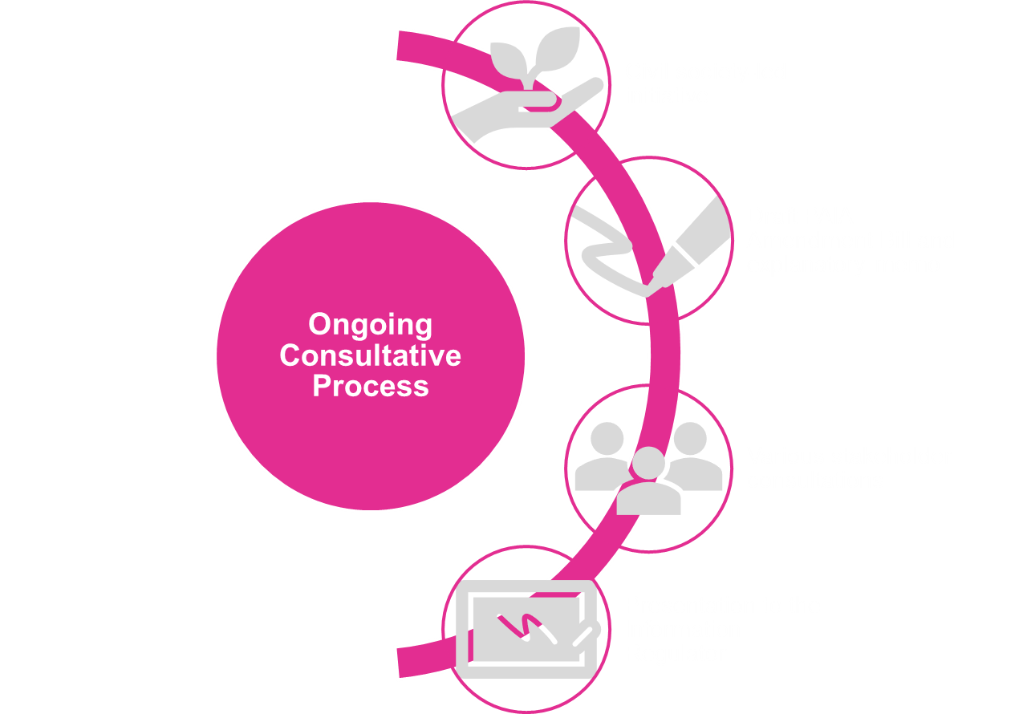
Ongoing Review and Developments
Voluntary policy commitments by government (e.g. Open Government Partnership; South Africa Connect; National eGovernment Strategy)
Court rulings through strategic litigation (e.g. Arena Holdings v SARS [2023] ZACC 13; Ibex v Tiso Blackstar [2024] ZASCA 166)
Regional human rights norms and standards (e.g. Guidelines on Access to Information and Elections; ACHPR Resolution on Data Access, 2024)

Slide 5
FOR MORE INFORMATION ON THE PAIA REFORM PROJECT:
Izak Minnaar | Media Consultant E: izak.minnaar@gmail.com | William Bird | Media Monitoring Africa E: williamb@mma.org.za | Avani Singh | Legal specialist E: avani.rsa@outlook.com
https://www.mediamonitoringafrica.org/democracy-governance/paia-reform/

